Slide 1
Find My phone
By:
Seshu Kumar Gandhapuneni
Ronak Bakshi
Manohar Reddy Sokkula

Slide 2
Purpose
To find the location of your android phone/tablet and iPhone/iPad
To play music on your android phone when in silent

Slide 3
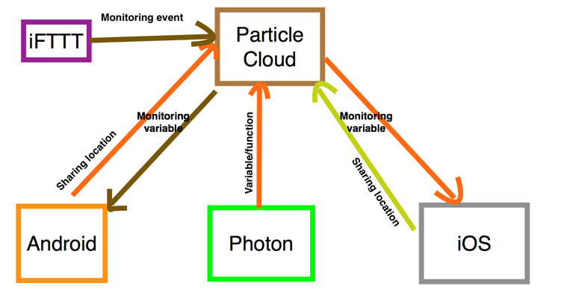
How it works
Music in Android phone is being triggered by IFTTT
Individual apps created for iOS and Android

Slide 4
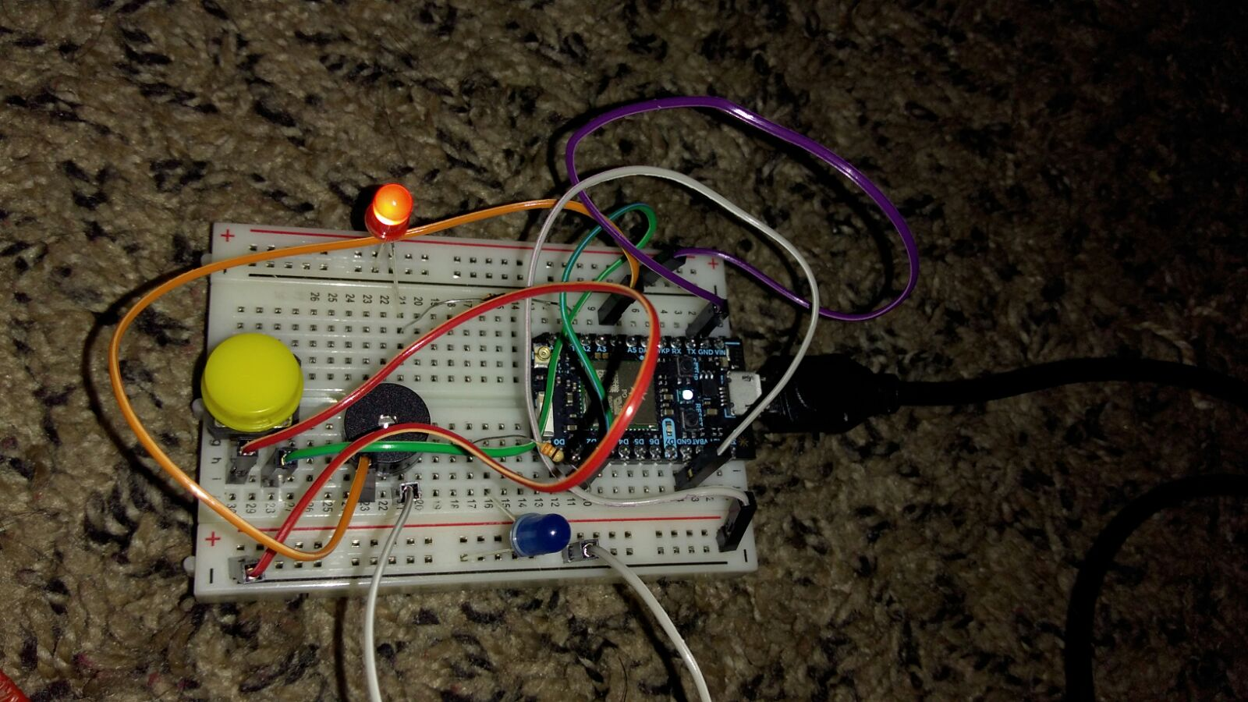
circuit

Slide 5
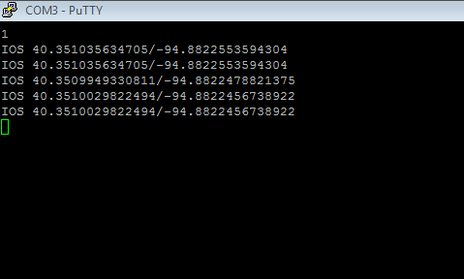
DEMO

Slide 6
Difficulties faced
Getting an idea
Playing with JSON data
Finding a common time to meet up

Slide 7
Future enhancements
Get the GP20u7 sensor working to get the location of photon
Calculate the distance between the photon and the phone
Convert the latitude and longitude to a specific address

Slide 8
Thank you!

